Slide 1


TypeScript, Now.
Code Mania
10
Suthep Sangvirotjanaphat
GreatFriends.Biz Founder | Microsoft MVP
http:||Next.GreatFriends.Biz
facebook.com|suthep

Slide 2
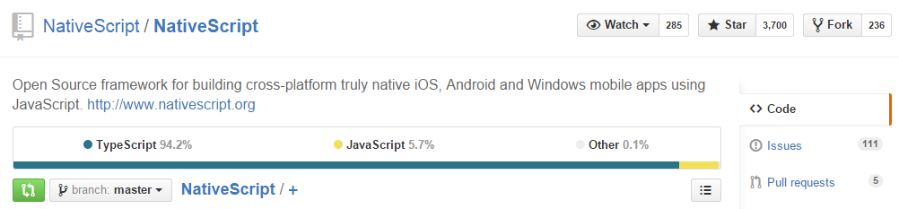
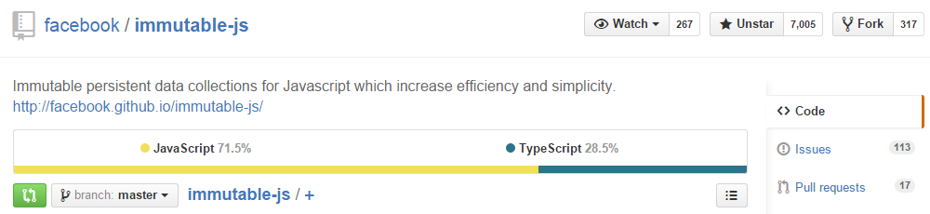
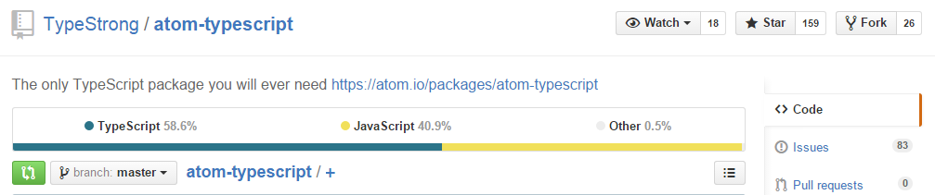

Slide 3
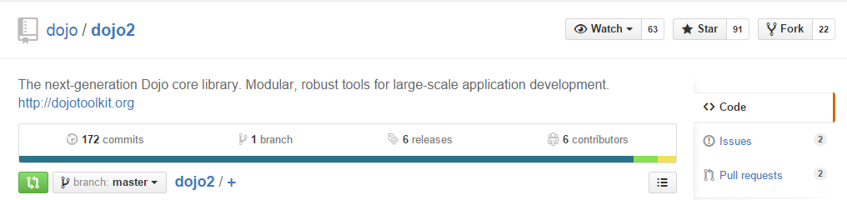
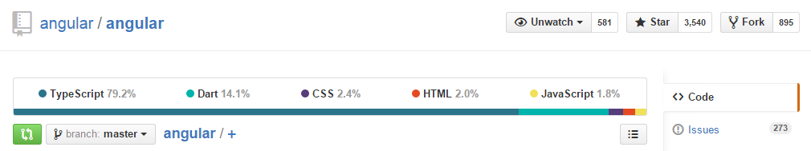
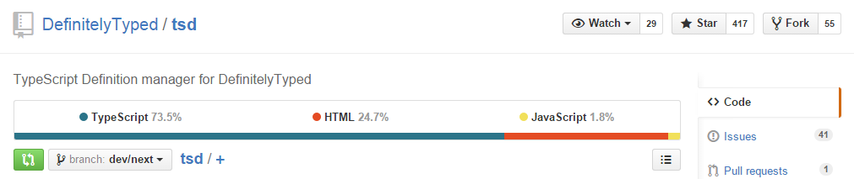

Slide 4

TypeScript
TypeScript is a superset of JavaScript that compiles to clean JavaScript output.

Slide 5
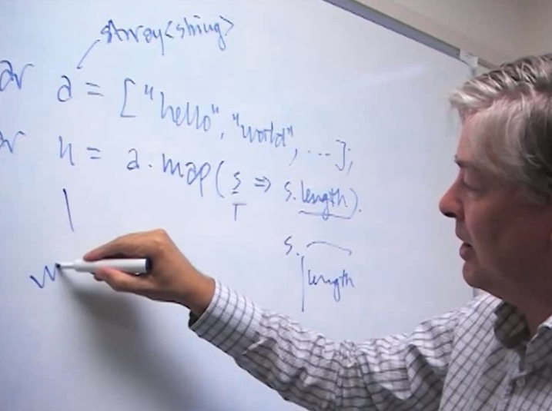
Anders Hejlsberg
Generics
type inference
lambda expression
Tooling. Intellisense support.

Slide 6
So, we'll try the same code in the playground

Slide 7
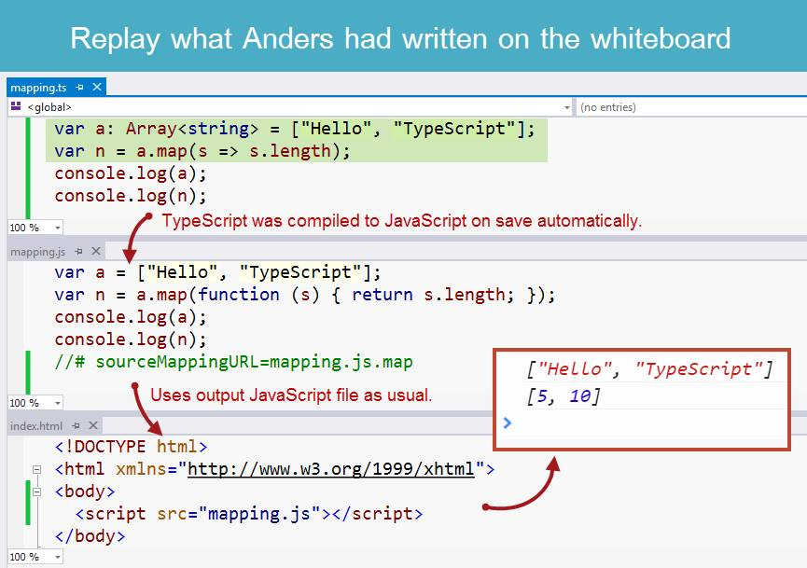

Slide 8
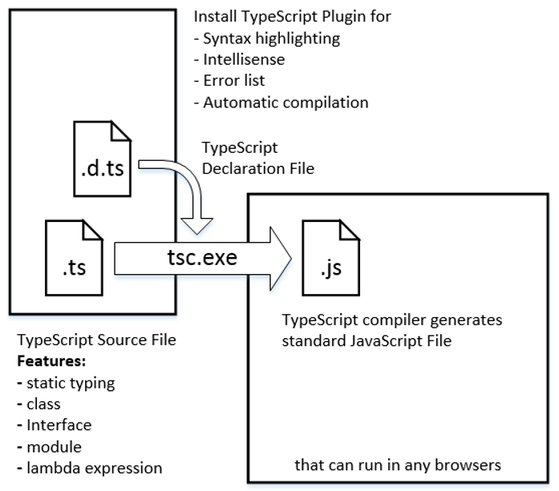

Slide 9
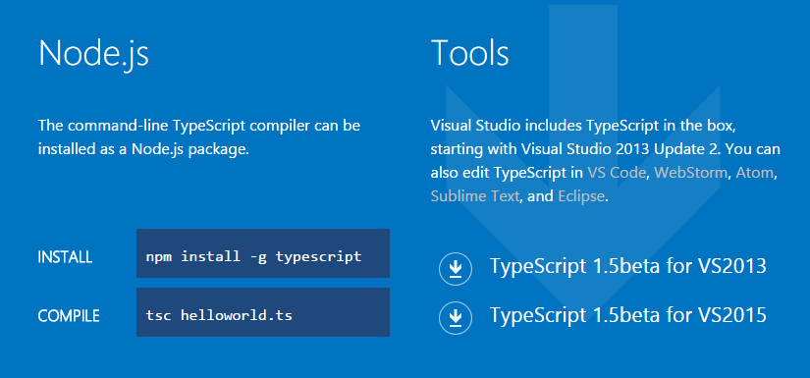
Get TypeScript

Slide 10
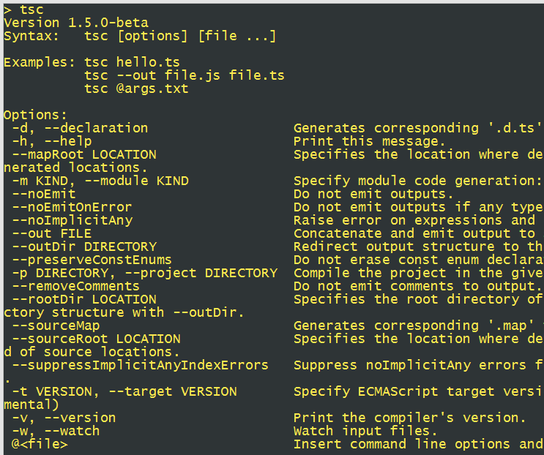
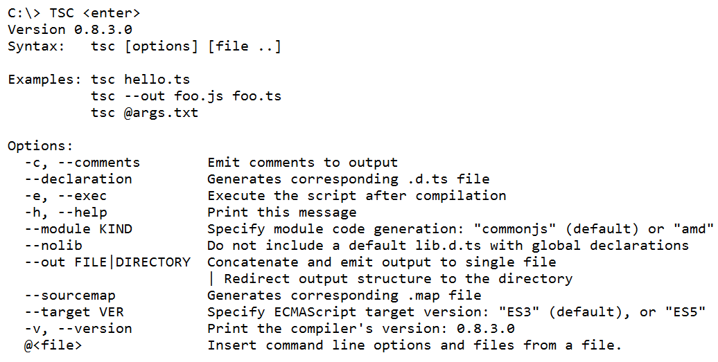

Slide 11
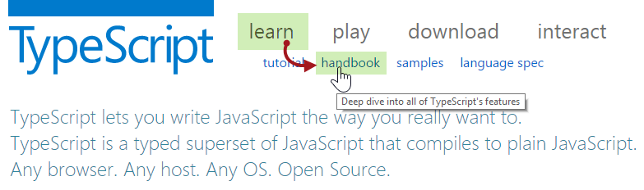

Slide 12
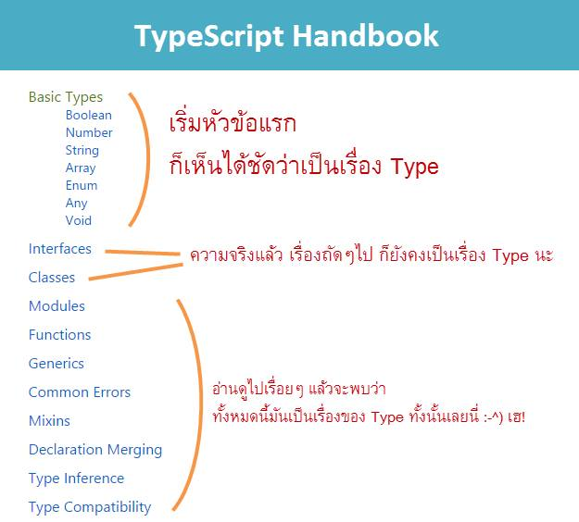

Slide 13
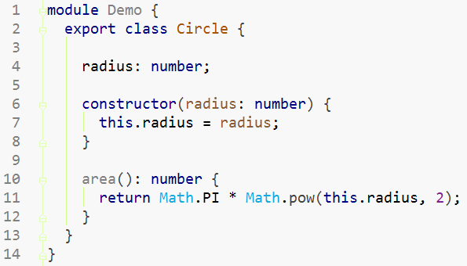

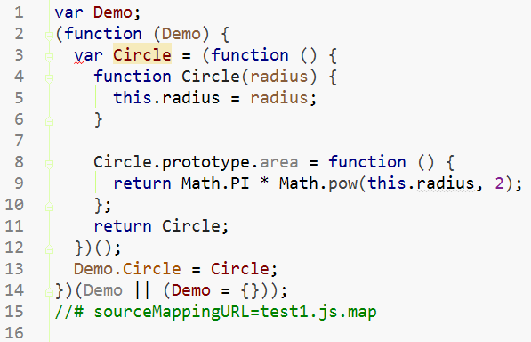


Slide 14
Type annotation
var x : number;
x = true; // error
x = 100; // ok
function print(s : string) : void {
console.log(s);
}
print(x); // error
print(x.toString()); // ok

Slide 15
Type inference
var x = 10; // infer x as a number
var x : number = 10;
// infer this function return type as string
function Foo(n: number) { return n.toFixed(2); }
function Foo(n: number) : string { … }

Slide 16
Basic types
boolean // var b = true, c = false;
number // var n = 100, m = 10.0;
string // var s = 'Hello';
array // var a1: number[] = [ 1, 3, 5 ];
array // var a2: Array<number> = [ ];
enum // var c = Color.red;
any // var x;
void // foo(): void { }

Slide 17
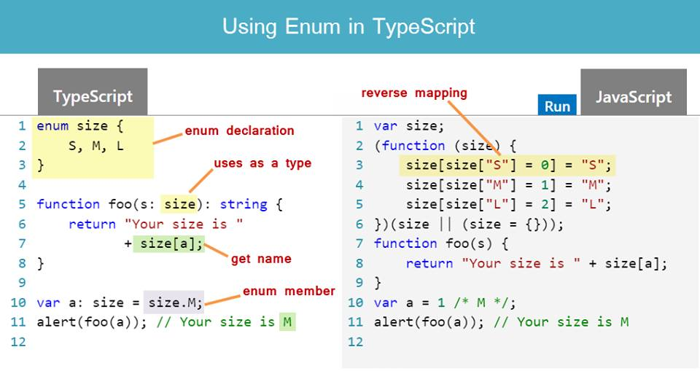
enum
*Typo: please change size[a] to size[s]

Slide 18
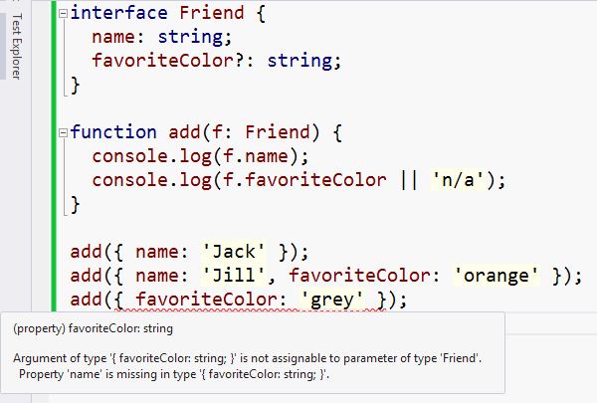
Interface and duck typing

Slide 19
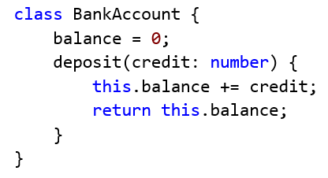
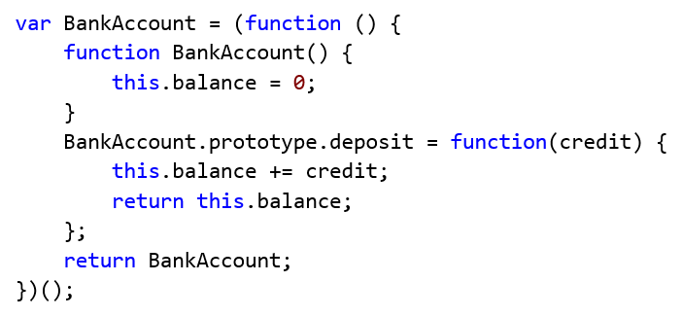
Class

Slide 20
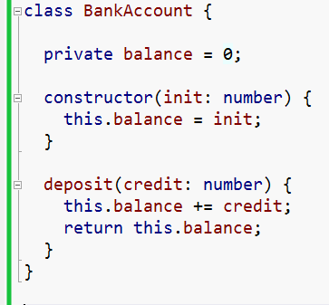
Constructor & Private Members

Slide 21
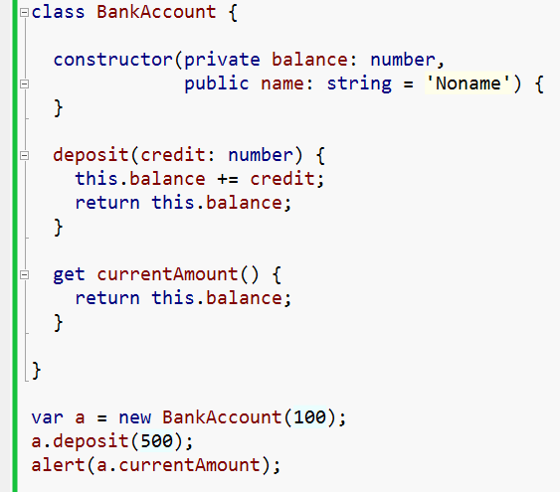
Parameter Properties & Accessors
Note that accessor (get & set) requires ES5 output

Slide 22
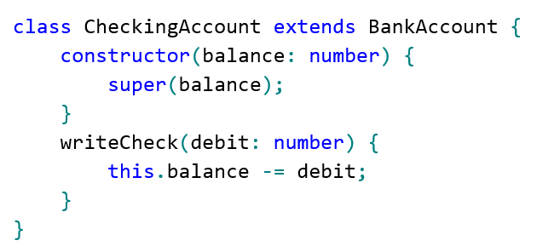
Class Inheritance and the "super" calls

Slide 23
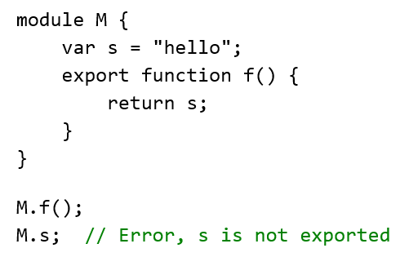
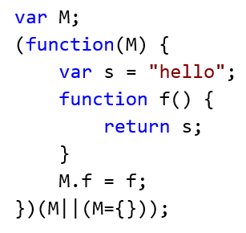
Module

Slide 24
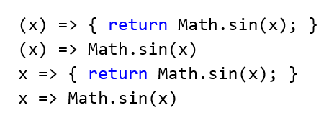
Arrow functions

Slide 25
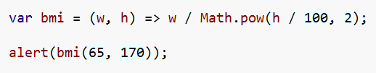

Arrow functions

Slide 26
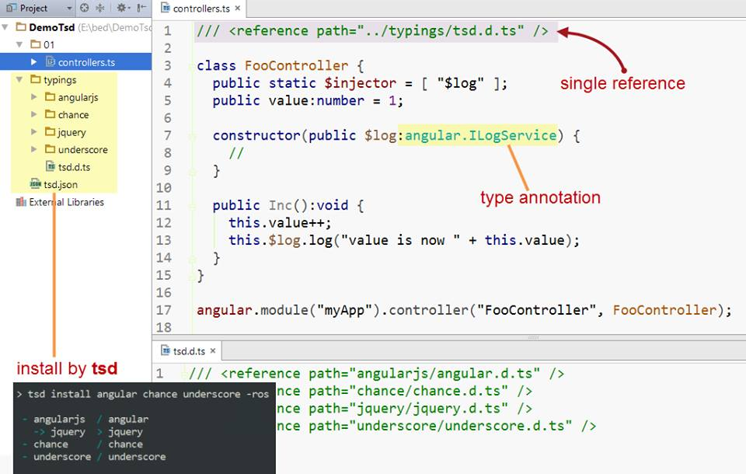
Using TypeScript with AngularJS

Slide 27
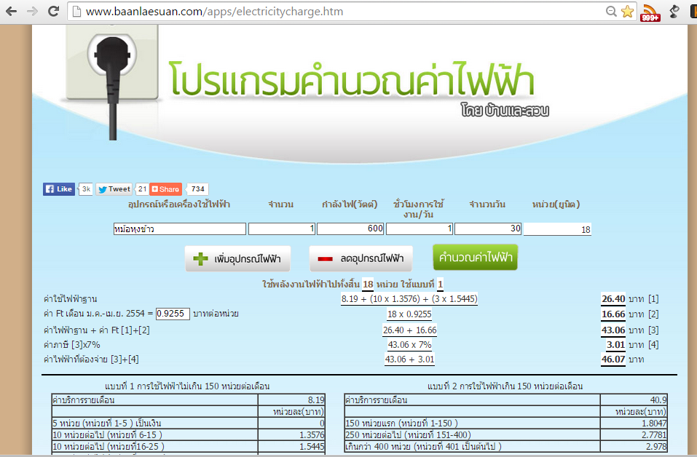
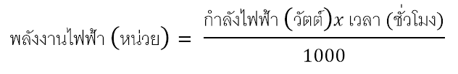
http://www.baanlaesuan.com/apps/electricitycharge.htm

Slide 28
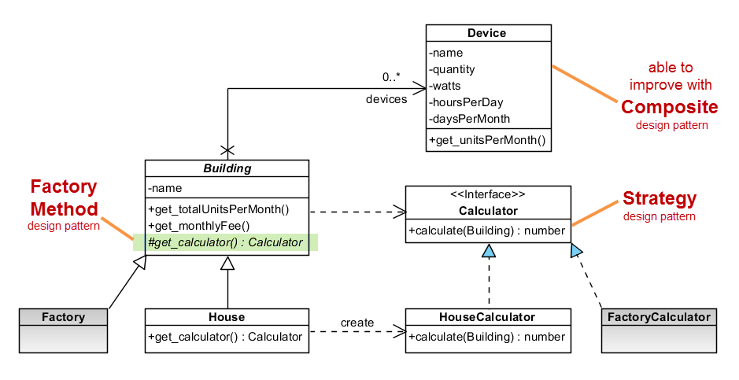
Developing with TypeScript

Slide 29
Resources
http://facebook.com/groups/typescript.thailand
http://www.typescriptlang.org
http://www.typescriptlang.org/Handbook
http://blogs.msdn.com/b/typescript
http://definitelytyped.org
http://definitelytyped.org/tsd
https://github.com/microsoft/typescript
https://github.com/microsoft/typescript/wiki

